Slide 1

Capstone Project Sprint 2
FixFlow
Maintenance Management System

Slide 2
Agenda
Project Description
Descriptive Minimal Viable Product
Diagrams
Acceptance Criteria & User Strories
Sprint backlog and Test case summary
Team Metrics

Slide 3
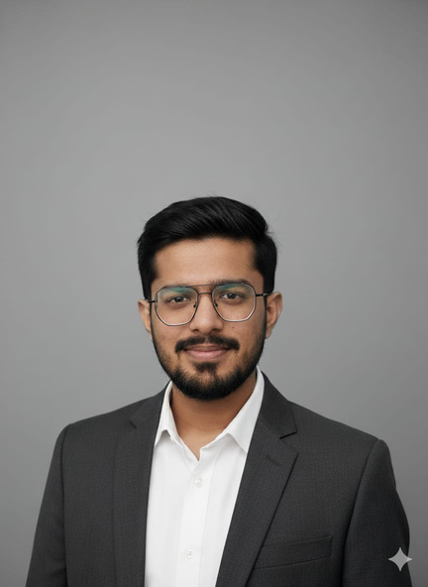

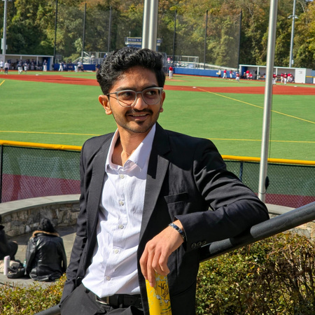
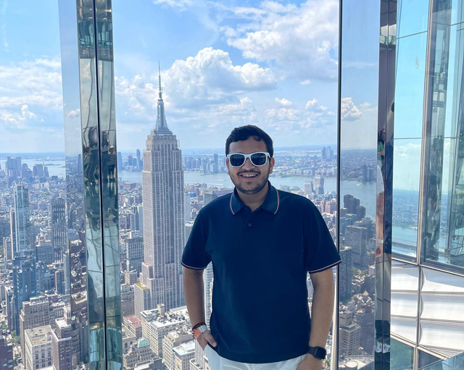
Team Members
Viraj Chokshi
Shriken Patel
Harshil Goti
Krish Jasani
Developer and DBA
Developer
Developer
Developer

Slide 4
Improvements made from professor’s feedback
User Stories & acceptance criteria: Improved from the previous presentation, according to the template provided.
Slides Sequence: The slides are following the checklist sequence unlike the previous presentation.

Slide 5
Project Description
FixFlow is a mobile-first maintenance management ecosystem designed to eliminate the inefficiencies of traditional facility reporting through a photo-centric, "smart triage" approach. By mandating visual evidence during the submission process and utilizing a backend priority engine, the platform automatically categorizes and ranks work orders based on severity, ensuring that critical issues like leaks or electrical hazards are addressed immediately. The system bridges the gap between residents and management by providing tenants with live status tracking and administrators with a data-rich dashboard, backed by a robust audit log that ensures 100% transparency and accountability for every repair.

Slide 6
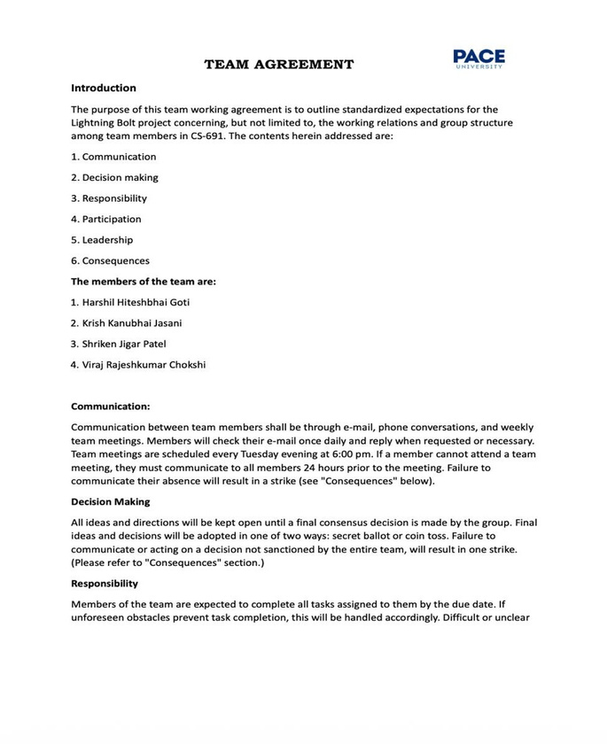
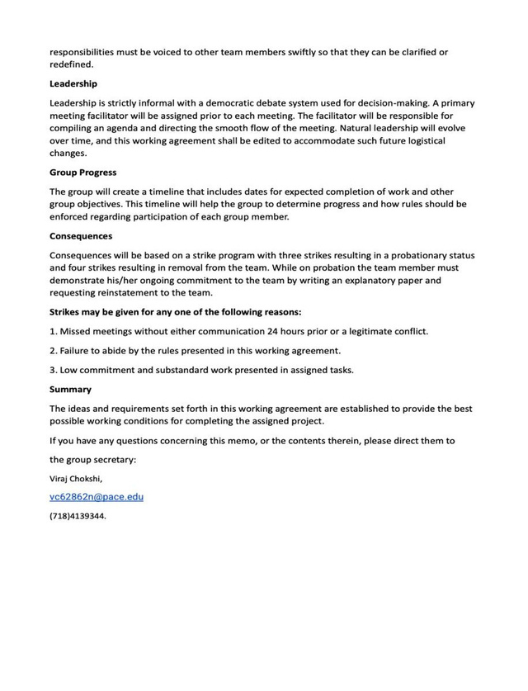
Team Working Agreement

Slide 7

Persona 1
Profile
Frustrations:
•Not knowing if his maintenance request was actually received.
•Maintenance staff showing up when he is in the middle of a remote exam.
•Having to explain the same issue multiple times to different people.
Goals:
•Reporting a problem in under 30 seconds.
•Getting real-time notifications about when a technician will arrive.
•Having a functional, safe living space to study in.
Marcus is a 20-year-old Junior at Pace University living in an on-campus residence hall. He is a full-time student with a heavy course load and a part-time job. He doesn't have time to wait on hold with campus security or visit the facilities office in person. He relies entirely on his smartphone to manage his life.
•Name: Marcus
•Age: 20
•Location: New York, NY (Pace University Housing)
•Status: Student / Resident
•Tech Literacy: High (Prefers apps over phone calls)
Living Situation: Shared Suite

Slide 8
Persona 2
Profile
Frustrations:
•Walking across a large campus only to find he brought the wrong tools for the job.
•Illegible handwritten notes or vague descriptions like "it's broken."
•Getting blamed for delays when he wasn't notified of a priority emergency.
Goals:
•Seeing a photo of the issue before he leaves the shop to prepare.
•Closing out tickets digitally so he doesn't have to do paperwork at the end of the day.
•Efficiently completing his daily route to reduce overtime.
Marcus is a 20-year-old Junior at Pace University living in an on-campus residence hall. He is a full-time student with a heavy course load and a part-time job. He doesn't have time to wait on hold with campus security or visit the facilities office in person. He relies entirely on his smartphone to manage his life.Profile: David is a 45-year-old lead maintenance technician with 15 years of experience. He is skilled at his job but often frustrated by the lack of information in work orders. He hates arriving at a "clogged sink" only to realize he needs a specific industrial snake tool that he left back at the central workshop, 15 minutes away.
•Name: David
•Age: 45
•Location: Westchester, NY
•Job: Facilities Technician
•Work Style: Practical, hands-on, mobile.
•Family: Married with two kids.

Slide 9
Persona 3
Profile
Frustrations:
•Having no clear data on how long it takes for a ticket to go from "Open" to "Closed."
•Dealing with angry parents/residents complaining about ignored requests.
•Unpredictable repair costs caused by small issues turning into major floods.
Goals:
•Identifying recurring issues (e.g., "Building B has constant pipe leaks") to justify renovations.
•Ensuring the maintenance team is meeting their Service Level Agreements (SLAs).
•Maintaining a 100% digital audit trail for liability and safety compliance.
Profile: Elena is a 38-year-old Property Manager responsible for three large dormitory buildings. She needs to keep costs low and resident satisfaction high. She cares about "the big picture"—knowing which buildings have the most issues and ensuring her team is working efficiently. She is the person who will be interested in the "Audit Logs" you mentioned.
•Name: Elena
•Age: 38
•Location: New York, NY
•Job: Senior Property Manager
•Tech Literacy: Moderate (Wants clean, easy-to-read data)
•Interests: Data analytics, budget optimization.

Slide 10

Minimal Viable Product
🎫 Ticket Management
Priority & category classification
Assign technician via modal
Status transitions with audit log
Attachments + threaded comments
📊 Role Dashboards
Admin: KPIs, ticket charts, revenue
Technician: queue & workload
Finance: revenue & payment stats
Customer: personal ticket feed
📑 Estimates & Invoices
Line-item estimates linked to tickets
One-click convert to invoice
PDF-ready detail pages
Status workflow: draft → approved

Slide 11

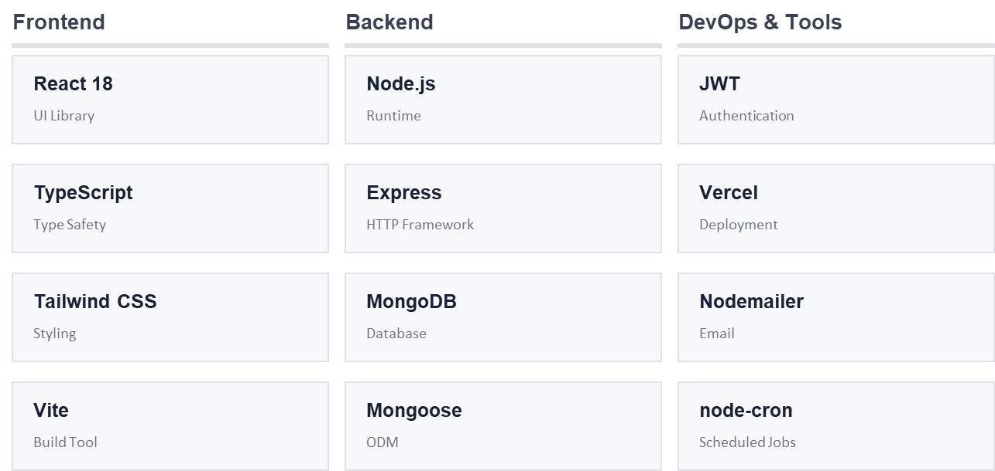

Slide 12
Diagrams
Architecture Diagram
Sequence Diagram
Context Diagram
State Diagram
ER Diagram
Class Diagram

Slide 13
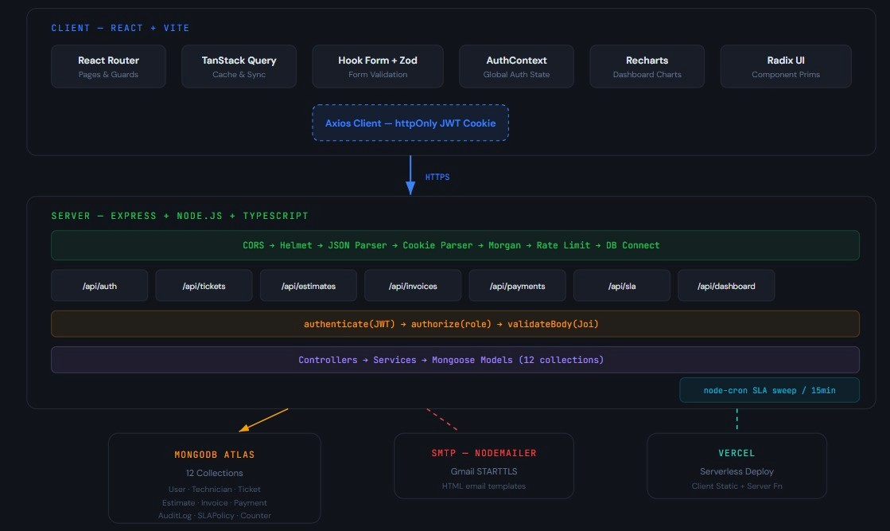
Architecture Diagram

Slide 14
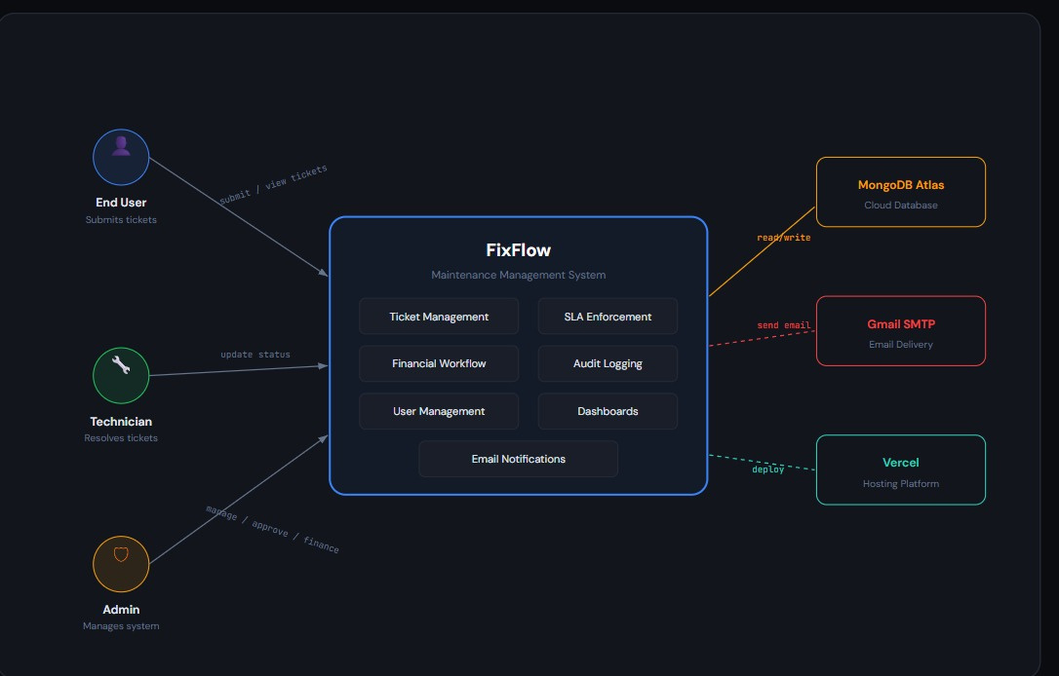
Context Diagram

Slide 15
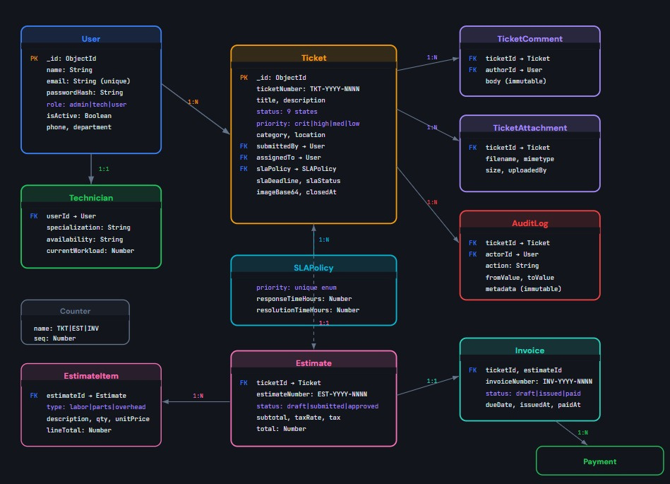
ER Diagram

Slide 16
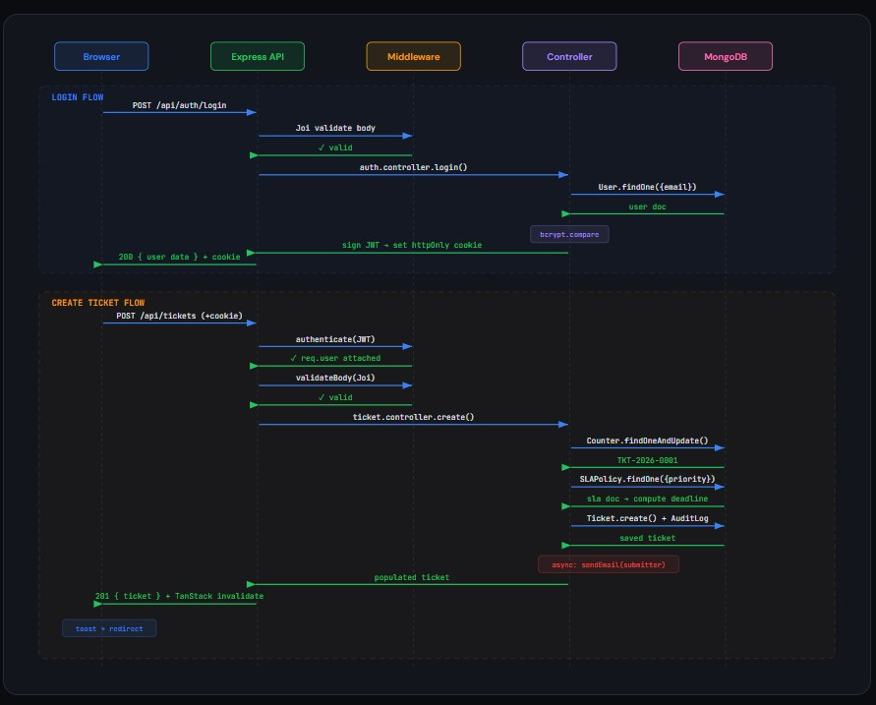
Sequence Diagram

Slide 17
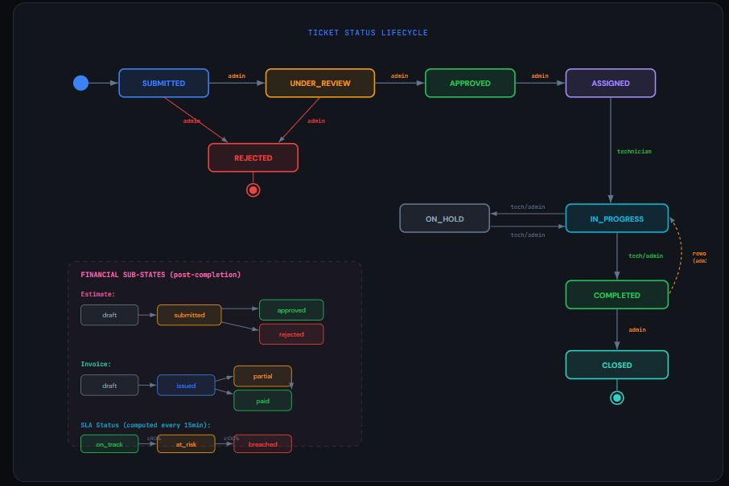
State Diagram

Slide 18
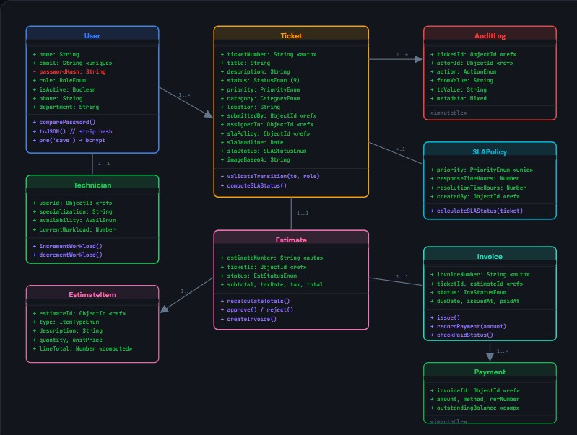
Class Diagram

Slide 19
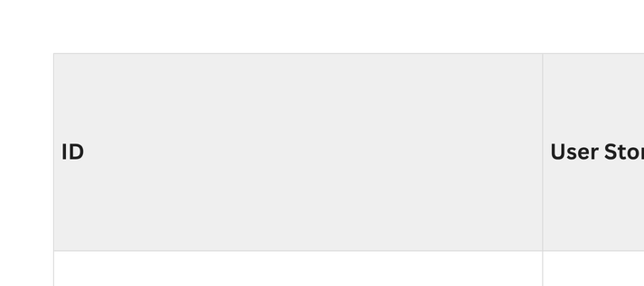
Acceptance Criteria & User Stories
Authentication

Slide 20
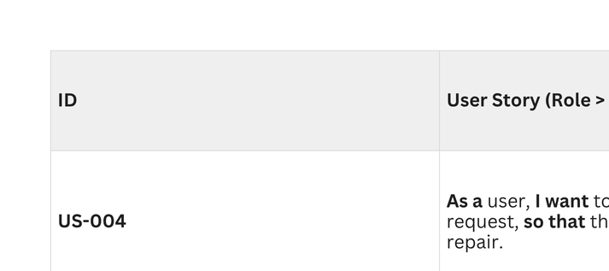
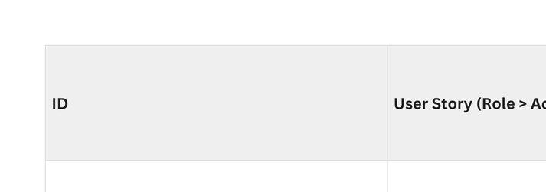
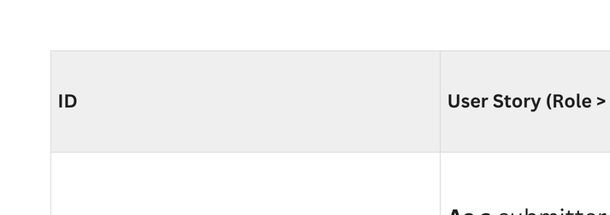
Ticket Management
SLA Management
Email Notifications

Slide 21
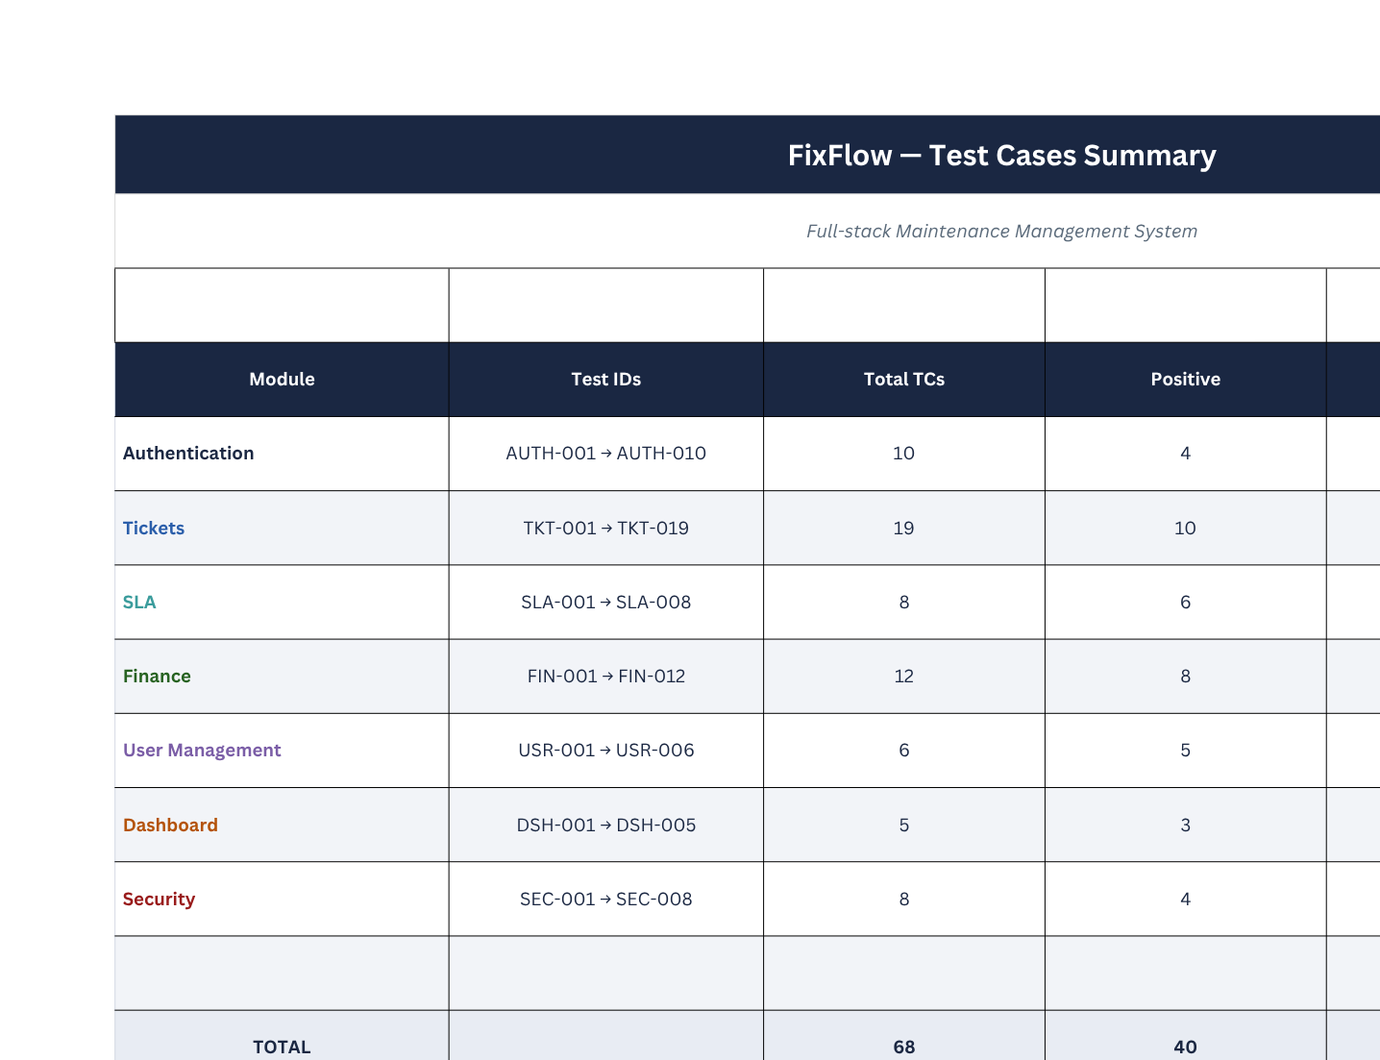

Slide 22
Stories Completed:
End-to-End Ticket Lifecycle
(Submission → Review → Approval → Assignment → Completion → Closure)
SLA Tracking System
(Priority-based deadlines with auto monitoring & breach detection)
Financial Workflow
(Estimates, invoices, and payment tracking per ticket)
Email Notifications
(Automated updates on ticket status changes)
Dashboard & Reporting
(KPIs, workload tracking, and system insights)
Logging
(Full history of all ticket actions)
Role-Based Access Control
(Admin, Technician, User with secure permissions)

Slide 23
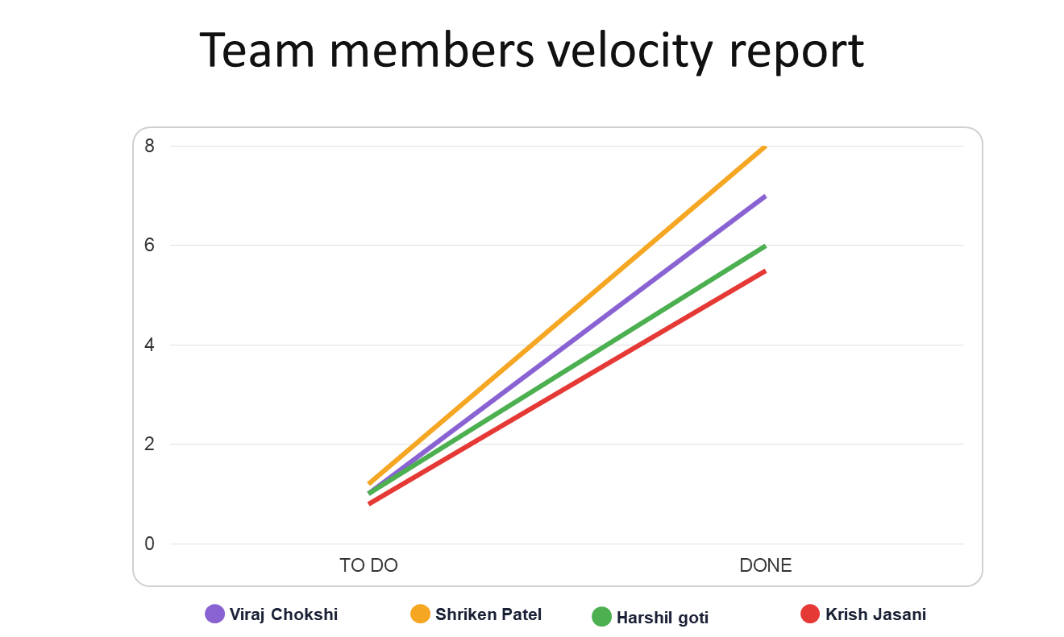

Slide 24

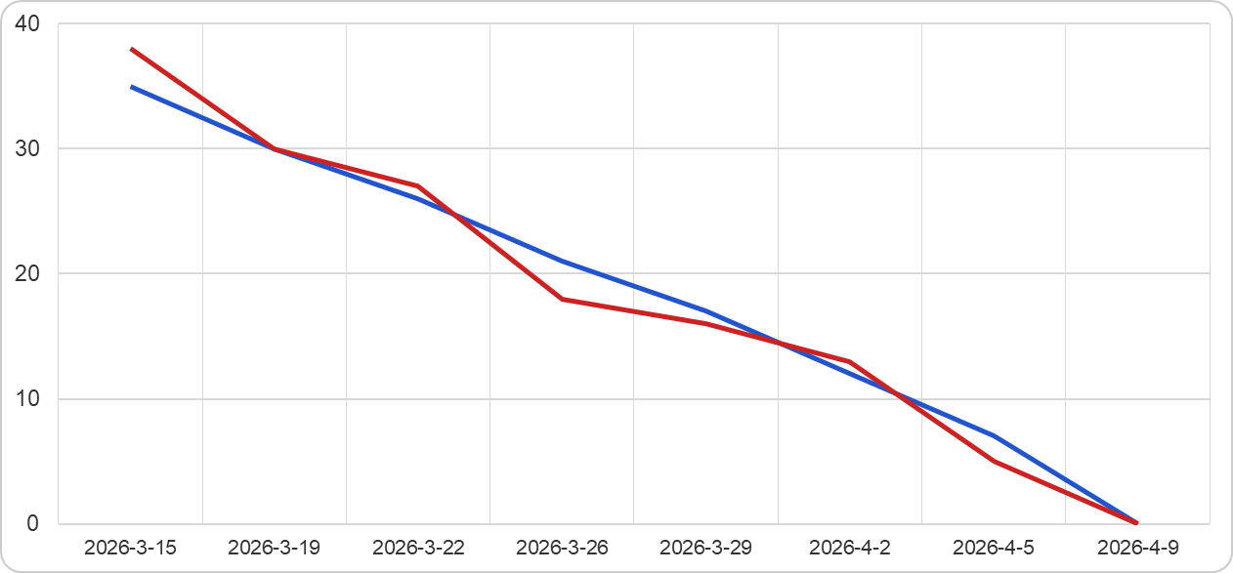

Slide 25
Sprint Retrospective
Went Well
Needs Improvement
•Strong team collaboration throughout the sprint
•All critical bugs resolved before demo
•Daily standups stayed focused & time-boxed
•Code reviews completed within 24 hours
•SLA engine delivered on schedule
•Good test coverage on ticket module
•Sprint planning took too long (3h+)
•Some stories were under-estimated
•Documentation updated late in sprint
•QA handoff had gaps in acceptance criteria
•Finance module delayed mid-sprint
•Tech debt not being tracked formally

Slide 26
Sprint Retrospective
Stop Doing
Action Items
•Skipping retrospective action follow-ups
•Direct commits to main branch
•Leaving PR reviews open >48h
•Inconsistent commit message formats
•Unplanned scope additions mid-sprint
•Add story point cap: max 3 per unestimated task
•Create DoD checklist for all tickets
•Set up automated linting for commit messages
•Block main branch — PRs required
•Tech debt backlog item added each sprint
•Acceptance criteria mandatory before sprint start

Slide 27
Stories Planned for Sprint 4 (product backlog):
🔹 Continue UI/UX enhancements for better usability
🔹 Implement advanced reporting dashboards
🔹 Improve notification system reliability
🔹 Optimize system performance & database queries
🔹 Enhance security mechanisms
🔹 Set up CI/CD pipeline & monitoring tools

Slide 29
Thank you

